Slide 1



CALENDAR APPLICATION
NAME : Dharaneesh.C
ROLL NO. : 23ADR030
JAIHARI D

Slide 2
Modules in the application
The primary modules used are;
Event Management Module:
Handles the creation, storage, and display of events with specific dates.
Calendar Display Module:
Generates and displays a view of the current month, showing dates according to the days of the week.
Date Navigation Module:
Provides the functionality to navigate between months, allowing the user to switch between the current, previous, and next months.
User Interaction Module:
The interaction between the user and the application, handling input and output through a menu system.

Slide 3
Concepts Used:
In this Java calendar application, several concepts are applied.The concepts used are:
Object-Oriented Programming:
Classes and Objects.
Encapsulation.
Methods.
Basic Programming Concepts(Control flow):
ArrayList.
While loop.
Switch statements.
Conditionals.
Override.

Slide 4
Coding:
import java.time.LocalDate;
import java.time.format.TextStyle;
import java.util.ArrayList;
import java.util.Locale;
import java.util.Scanner;
class Event {
int day;
int month;
int year;
String description;
public Event(int day, int month, int year, String description) {
this.day = day;
this.month = month;
this.year = year;
this.description = description;
}
public String toString() {
return "Event on " + day + "/" + month + "/" + year + ": " + description;
}
}
public class CombinedCalendarApp {
private ArrayList<Event> events;
private LocalDate currentDate;
public CombinedCalendarApp() {
events = new ArrayList<>();
currentDate = LocalDate.now();
}
public void addEvent(int day, int month, int year, String description) {
Event event = new Event(day, month, year, description);
events.add(event);
System.out.println("Event added successfully.");
}
public void viewEvents(int day, int month, int year) {
System.out.println("Events on " + day + "/" + month + "/" + year + ":");
boolean found = false;
for (Event event : events) {
if (event.day == day && event.month == month && event.year == year) {
System.out.println(event);
found = true;
}
}
if (!found) {
System.out.println("No events found for this date.");
}
}
public void displayCalendar() {
LocalDate firstDayOfMonth = currentDate.withDayOfMonth(1);
int lengthOfMonth = currentDate.lengthOfMonth();
int startingDayOfWeek = firstDayOfMonth.getDayOfWeek().getValue();

Slide 5
System.out.println("4. Next Month");
System.out.println("5. Previous Month");
System.out.println("6. Exit");
System.out.print("Choose an option: ");
int choice = scanner.nextInt();
switch (choice) {
case 1:
calendarApp.displayCalendar();
break;
case 2:
System.out.print("Enter day: ");
int day = scanner.nextInt();
System.out.print("Enter month: ");
int month = scanner.nextInt();
System.out.print("Enter year: ");
int year = scanner.nextInt();
scanner.nextLine();
System.out.print("Enter event description: ");
String description = scanner.nextLine();
calendarApp.addEvent(day, month, year, description);
break;
case 3:
System.out.print("Enter day: ");
day = scanner.nextInt();
System.out.print("Enter month: ");
month = scanner.nextInt();
System.out.print("Enter year: ");
year = scanner.nextInt();
System.out.println("Calendar - " + currentDate.getMonth().getDisplayName(TextStyle.FULL, Locale.getDefault()) + " " + currentDate.getYear());
System.out.println("Sun Mon Tue Wed Thu Fri Sat");
for (int i = 1; i < startingDayOfWeek; i++) {
System.out.print(" ");
}
for (int day = 1; day <= lengthOfMonth; day++) {
System.out.printf("%3d ", day);
if ((startingDayOfWeek + day - 1) % 7 == 0) {
System.out.println();
}
}
System.out.println();
}
public void navigateMonth(int increment) {
currentDate = currentDate.plusMonths(increment);
}
public static void main(String[] args) {
CombinedCalendarApp calendarApp = new CombinedCalendarApp();
Scanner scanner = new Scanner(System.in);
while (true) {
System.out.println("\nCalendar Application");
System.out.println("1. Display Calendar");
System.out.println("2. Add Event");
System.out.println("3. View Events");

Slide 6
calendarApp.viewEvents(day, month, year);
break;
case 4:
calendarApp.navigateMonth(1);
break;
case 5:
calendarApp.navigateMonth(-1);
break;
case 6:
System.out.println("Exiting application.");
scanner.close();
return;
default:
System.out.println("Invalid choice. Please try again.");
}
}
}
}

Slide 7
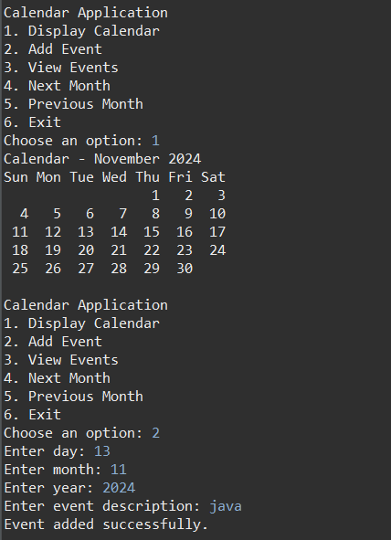
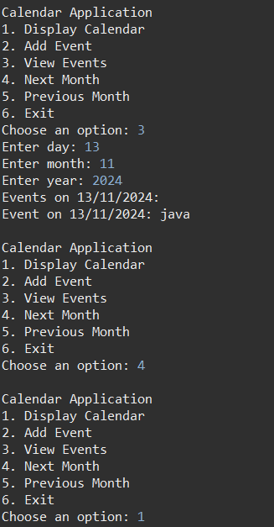
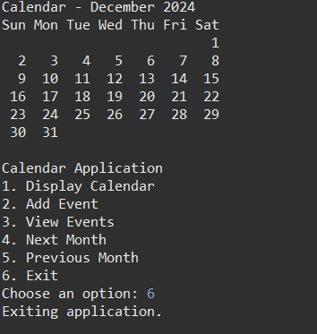
Result:

Slide 8
Thank you!

